Slide 1
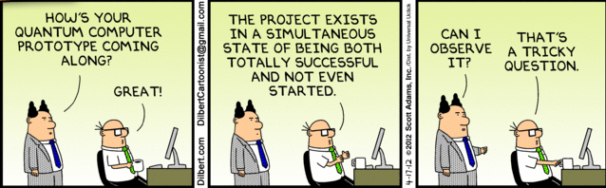
Quantum computers
and Schrödinger’s cat
D. J. Wineland, NIST, Boulder, Colorado
Dilbert confronts Schrödinger’s cat, 4/17/12

Slide 2
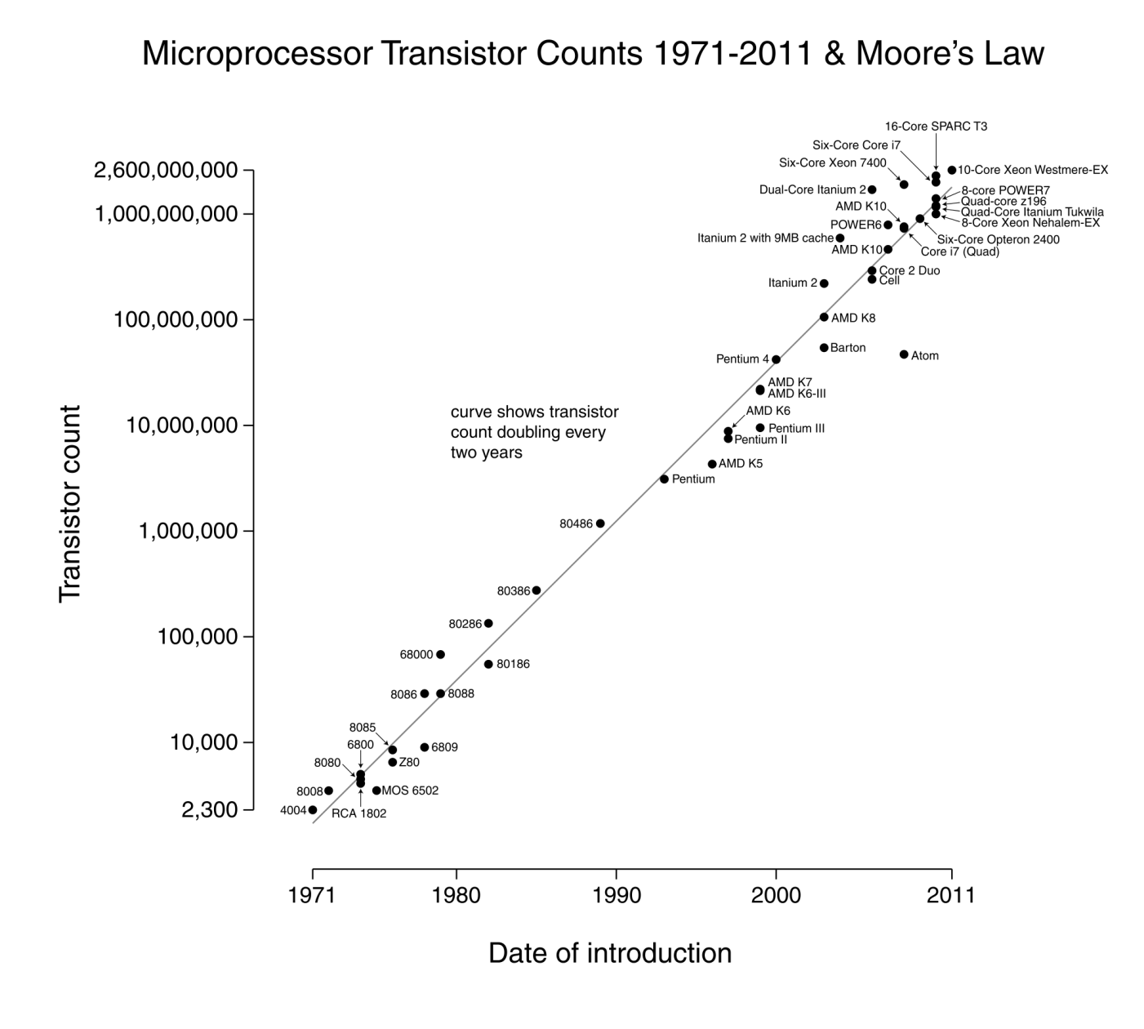
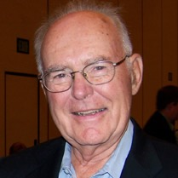
Moore’s “law” (1965): number of transistors/microprocessor
doubles every ~1½ years
quantum effects
manifest
Gordon Moore
(co-founder, Intel)
(from Wikipedia)

Slide 3
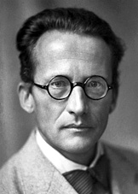
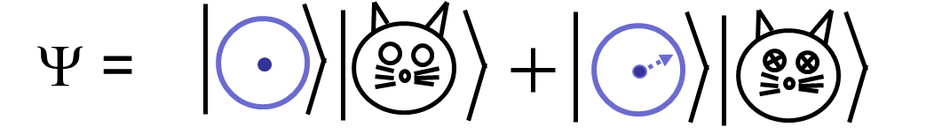
Erwin Schrödinger’s Cat (1935)
(extrapolating ideas of quantum mechanics
from microscopic to macroscopic world)
efficient
detector
sealed box
radioactive
particle
poison capsule
At “half-life” of particle, quantum mechanics says
cat is simultaneously dead and alive!
“superposition”
“entangled
superposition”

Slide 4
Analog of quantum superposition
“superposition states”
of a box
?
(a) and (b)
(a) or (b)
(a)
(b)
ambiguity about which state the box is in.
Box possesses both properties simultaneously
2. quantum measurement: collapse or “projection” into either state (a) or (b)
Fred Alan Wolf, "Taking the Quantum Leap" (Harper & Row, San Francisco, 1981)

Slide 5
Schrödinger (1952):
“We never experiment with just one electron or atom
or (small) molecule. In thought experiments, we
sometimes assume that we do; this invariably entails
ridiculous consequences…”
But “thought experiments” are now our world!
* need precise control + isolation from environment
* examples: atomic clocks and quantum computers
* personal tour, but many people and groups
involved world-wide
Ingredients:
* superpositions
* individual quantum systems
* control over relevant quantum states
TexPoint fonts used in EMF.
Read the TexPoint manual before you delete this box.: AAA

Slide 6
Examples of small superpositions
atom in “trap” is like a marble in a bowl
superposition of motion states:
atom in two places at once!
Ψ =|left⟩ + |right⟩
|1⟩
Superposition state:
|0⟩ + |1⟩
superposition
of atomic
energy levels
electron energy →
|0⟩

Slide 7
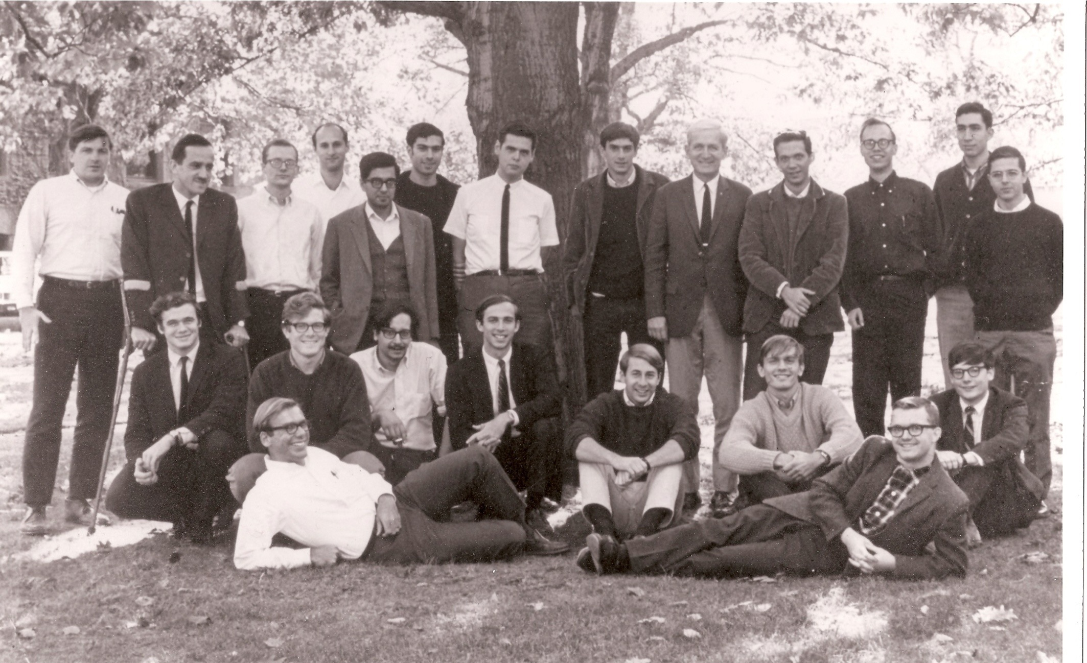
Norman Ramsey’s group, Harvard,1966
Thesis: atomic deuterium maser
deuterium “hyperfine” frequency:
f₀ = 327 384 352.5222(17) Hz
precise control of environment
long-lived (~ 1 s) superpositions
of hyperfine energy states
Doug Brenner Randy Wolfe
Ed Uzgiris Andrzej Chachulski Tom English Ashok Khosla Tom Follett Dave Wineland Norman Pat Gibbons Paul Zitzewitz Bill Edelstein Roger Hegstrom
Keith MacAdam Peter Moulton Bob Hilborn Peter Valberg Charles Minter
Frank Winkler Fraser Code

Slide 8
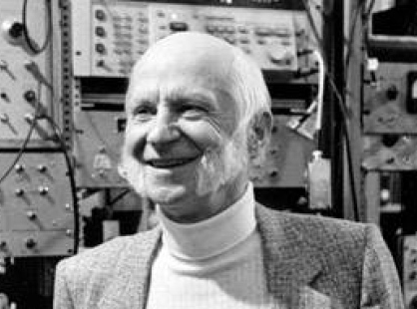
Hans Dehmelt’s lab (Univ. Washington)
- trapped electrons/ions:
trap electrodes
L_{e}(N)
Hans Dehmelt
C_{e}(N)
equivalent circuit:
Goal: electron magnetic
moment measurement:
smallest uncertainty with
single electrons, N = 1
N electrons/ions
signal out
α N

Slide 9
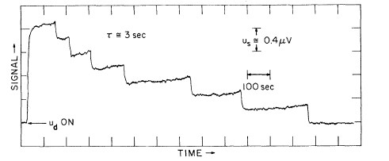
Precursor to magnetic moment measurement
R. S. Van Dyck, P. Schwinberg, H. Dehmelt, Phys. Rev. Lett. 38, 310 (1977)
Single electrons
single
electron
ELECTRON CURRENT α N →
D. Wineland, P. Ekstrom, and H. Dehmelt, Phys. Rev. Lett. 31, 1279 (1973).
signal out
α N

Slide 10
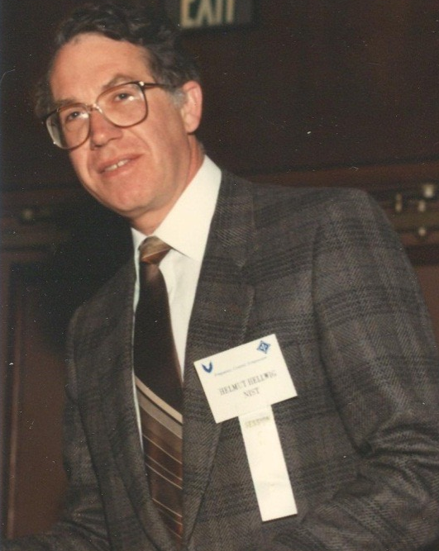
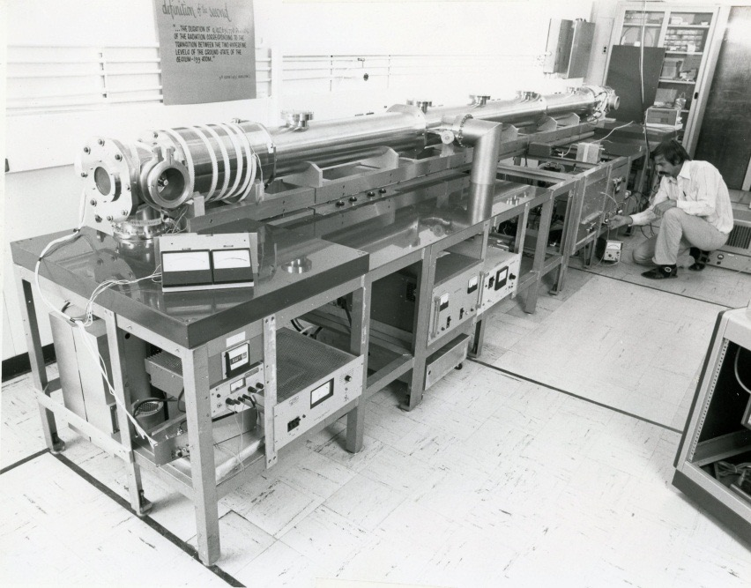
NIST, 1975 (National Institute of Standards and Technology)
(then NBS, National Bureau of Standards)
Group leader:
Helmut Hellwig
Built by David Glaze
Cs beam frequency standard
“NBS-6”
“laser cooling:” suppresses
frequency shifts due to relativity-
Einstein’s “twin paradox”

Slide 11
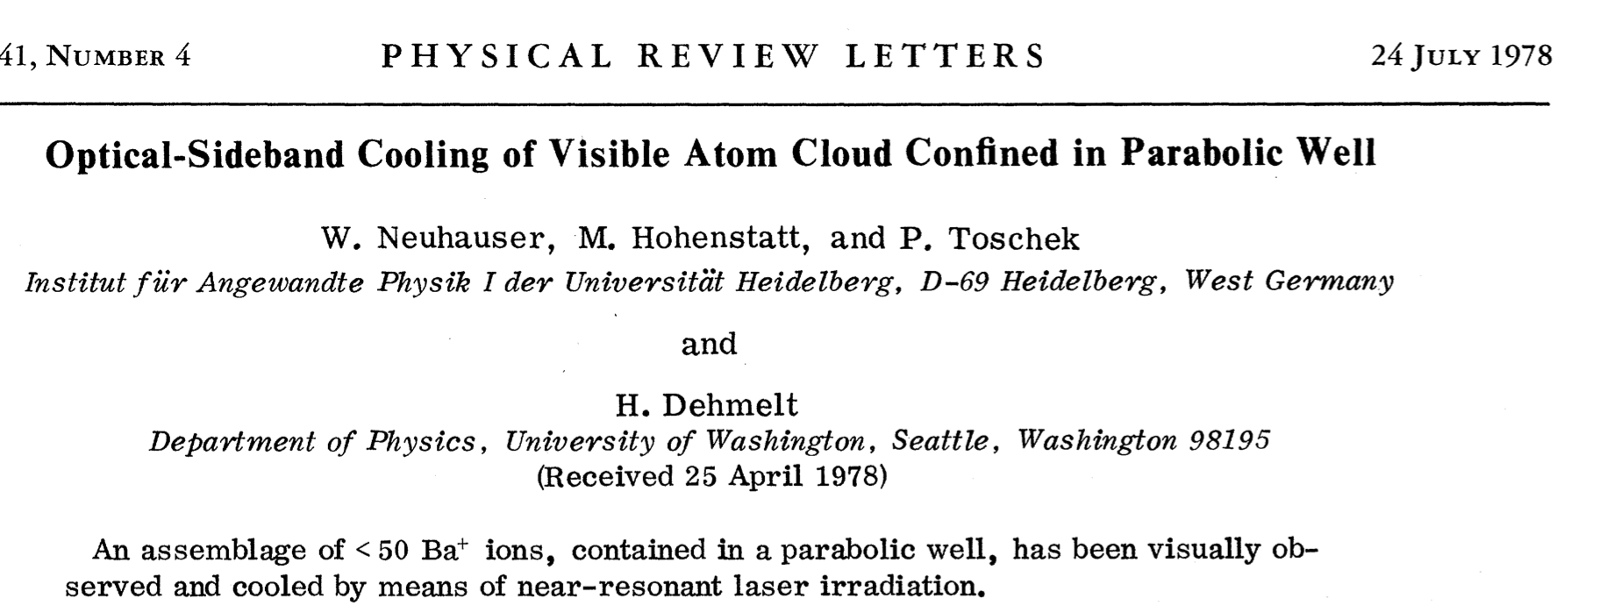
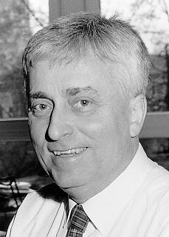
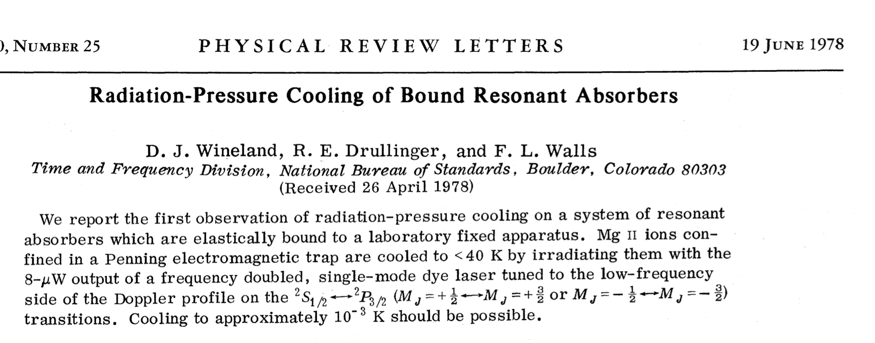
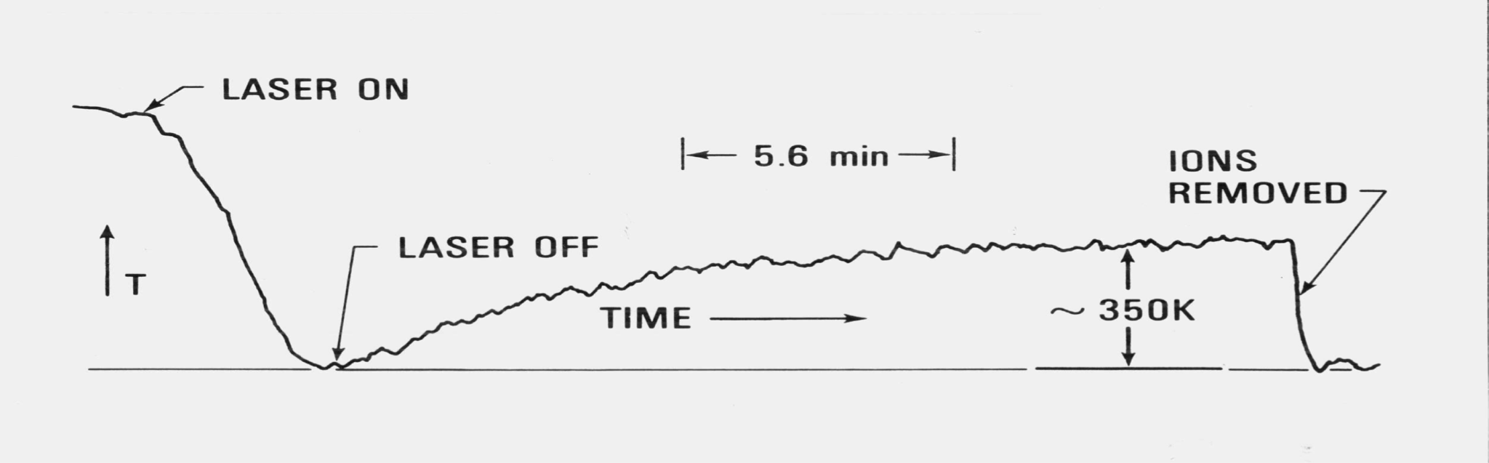
Peter Toschek
thermal current noise →

Slide 12
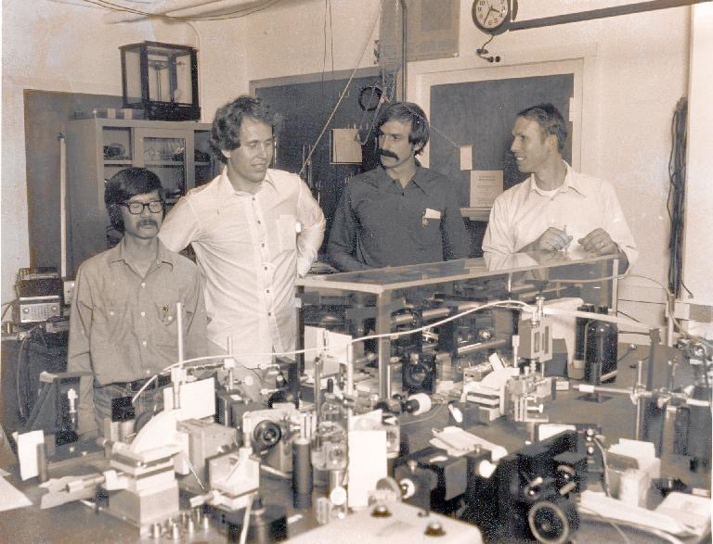
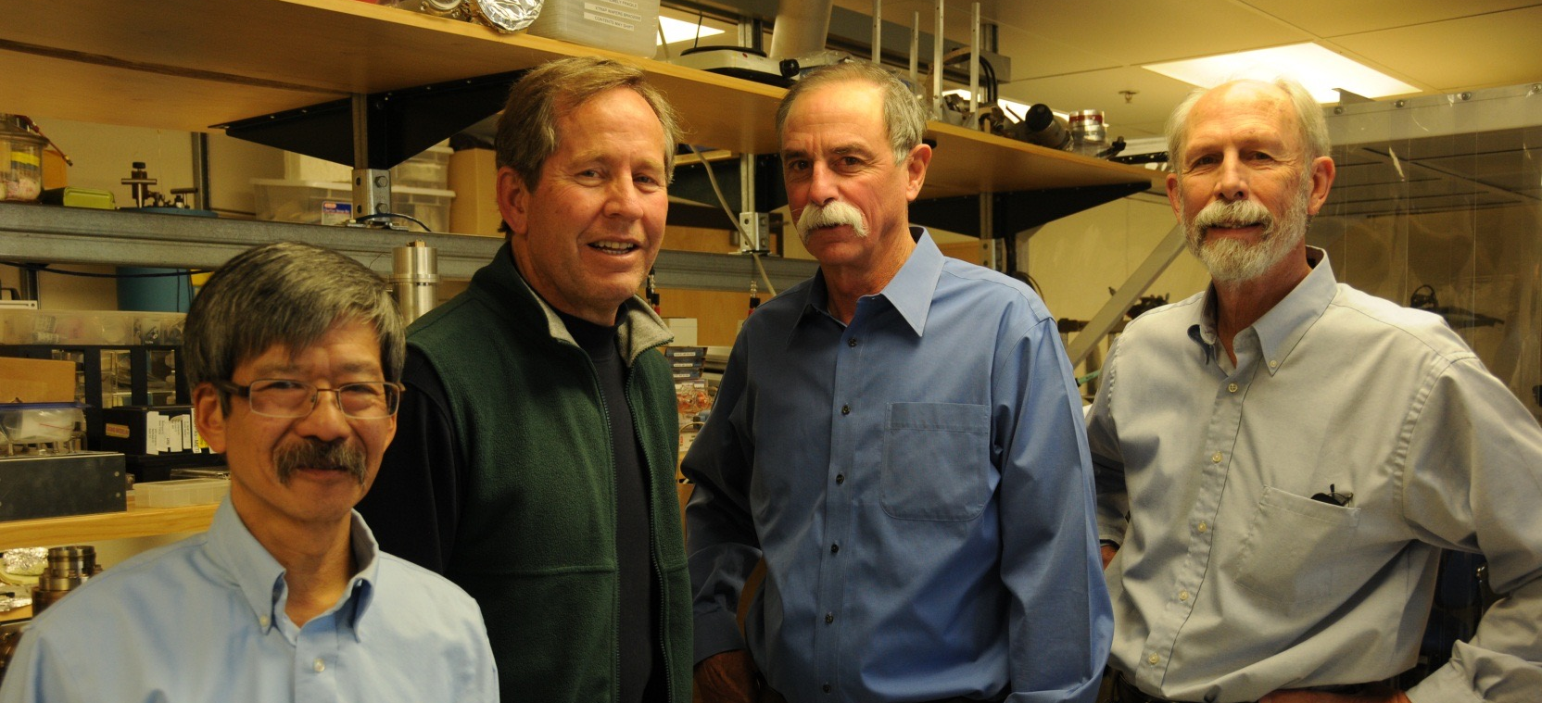
NBS “Ions”, 1979
Jim Bergquist
Dave Wineland
Bob Drullinger
Wayne Itano
2012

Slide 13
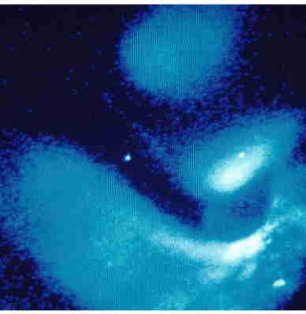
Mercury ion (Hg⁺) experiments at NIST, 1981 →
²P_{1/2}
“trap” electrodes
“Doppler”
laser cooling
T ~ 1 mK
Hg⁺
²S_{1/2}
194 nm
194 nm
1 mm
¹⁹⁹Hg⁺
Single Hg⁺ ion

Slide 14
Mercury ion quantum bit (“qubit”) experiments at NIST, 1981 →
superposition of “internal” energy states of ion
“trap” electrodes
|²D_{5/2}⟩ ≡ |1⟩, τ ≅ 0.1 s
e.g., |0⟩ → α|0⟩ + β|1⟩
|²S_{1/2}⟩ ≡ |0⟩
λ = 282 nm
ultraviolet light
¹⁹⁹Hg⁺
1 mm

Slide 15
Data storage:
• classical: computer bit: (0) or (1)
• quantum: “qubit” αï0ñ +βï1ñ superposition
(ï0ñ ANDï1ñ)
The quantum computer
measurement:
αï0ñ +βï1ñ “collapses” to
ï0ñ ORï1ñ
Scaling: Consider 3-bit register (N = 3):
Classical register: (example): (101)
Quantum register: (3 qubits):
Y= |0,0,0 ñ + |0,0,1 ñ + |0,1,0 ñ + |1,0,0 ñ
+ |0,1,1 ñ + |1,0,1 ñ + |1,1,0 ñ + |1,1,1ñ (represents 2³ numbers simultaneously)
OR
For N = 300 qubits, store 2³⁰⁰ ≈ 10⁹⁰ numbers simultaneously
      (more than all the classical information in universe!)
Parallel processing: single gate operates on all 2^{N} inputs simultaneously
But!: quantum measurement rule: measured register gives only one number
Factoring: Peter Shor’s Algorithm (1994)

Slide 16
measurement of mercury ion qubit superposition
αï0ñ +βï1ñ
|1⟩
Hg⁺
|0⟩
1 mm

Slide 17
measurement of mercury ion qubit superposition
αï0ñ +βï1ñ → ï0ñ
²P_{1/2}
|1⟩
Hg⁺
|0⟩
194 nm
1 mm
photomultiplier

Slide 18
measurement of mercury ion qubit superposition
αï0ñ +βï1ñ → ï0ñ
²P_{1/2}
|1⟩
Hg⁺
|0⟩
194 nm
1 mm
photomultiplier

Slide 19
fine-scale energy structure:
…
²D_{5/2}
m=2
m=1
²D_{5/2} = |1⟩
m=0
…
m=2
²S_{1/2}
m=1
m=0
motion quantum
states
²S_{1/2} = |0⟩
1 mm
¹⁹⁹Hg⁺

Slide 20
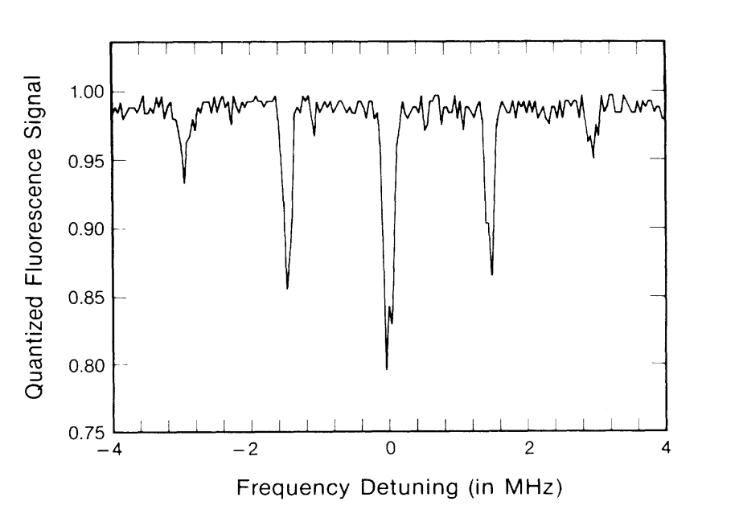
²P_{1/2}
alternately
apply
Single-ion spectroscopy:
²D_{5/2}
Hg⁺
282 nm
²S_{1/2}
Prob. (S_{1/2}) →
…
²D_{5/2}
m=2
m=1
m=0
Δm = 0
…
m=2
m=1
J. C. Bergquist, W. M. Itano, D. J. Wineland, Phys. Rev. A36, 428 (1987).
²S_{1/2}
m=0

Slide 21
²P_{1/2}
alternately
apply
…
…
²D_{5/2}
²D_{5/2}
m=2
²D_{5/2}
m=2
m=1
m=1
m=0
m=0
Δm = -1
Δm = +1
Hg⁺
282 nm
…
…
m=2
m=2
²S_{1/2}
²S_{1/2}
m=1
²S_{1/2}
m=1
m=0
m=0
Prob. (S_{1/2}) →
J. C. Bergquist, W. M. Itano, D. J. Wineland, Phys. Rev. A36, 428 (1987).

Slide 22
…
…
…
²D_{5/2}
m=2
²D_{5/2}
m=2
²D_{5/2}
m=2
m=1
m=1
m=1
m=0
m=0
m=0
Δm = -1
Δm = -1
Δm = -1
Δm = 0
Δm = 0
…
…
…
m=2
m=2
m=2
²S_{1/2}
m=1
²S_{1/2}
m=1
²S_{1/2}
m=1
m=0
m=0
m=0
Prob. (S_{1/2}) →
Ground-state cooling (put atom in m=0 motion state):
F. Diedrich et al., Phys. Rev. Lett. 62, 403 (1989)

Slide 23
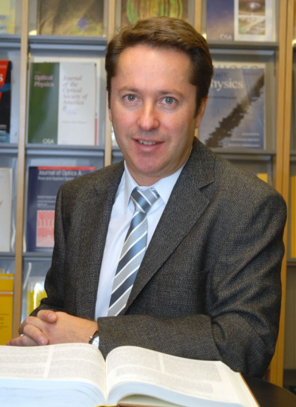
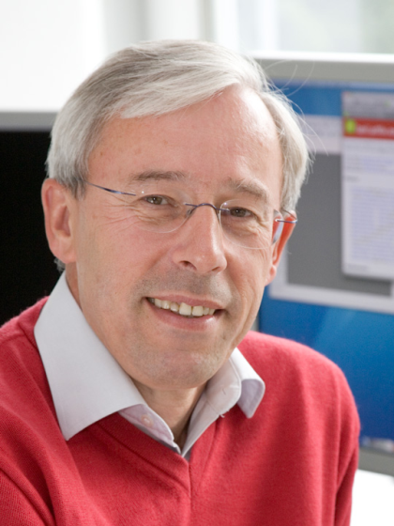
Atomic ion quantum computation:
(J. I. Cirac, P. Zoller, Phys. Rev. Lett. 74, 4091 (1995)
1. START MOTION IN GROUND STATE
2. SPIN → MOTION MAP
3. SPIN ↔ MOTION GATE
Ignacio Cirac
Peter Zoller
Ion “pseudomolecule”
MOTION “DATA BUS”
(e.g., center-of-mass mode)
INTERNAL STATE “SPIN” QUBIT
• • • •
• • • •
|1⟩
|m = 3⟩
|m = 2⟩
|m = 1⟩
|m = 0⟩
“m” for
motion
|0⟩
Motion qubit states

Slide 24
SPIN → MOTION MAP
●
●
●
m = 4
|1⟩
quantized motion levels
m = 3
m = 2
m = 1
m = 0
|0⟩
●
“π - pulse”
●
●
m = 4
m = 3
m = 2
m = 1
m = 0
(α|0⟩ + β|1⟩) |m=0⟩
→ |0⟩ (α|m=0⟩ + β|m=1⟩)
initial state
transfer superposition onto motion

Slide 25

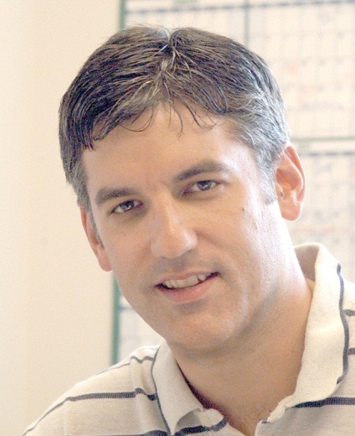
●
●
●
m = 4
|1⟩
m = 3
m = 2
m = 1
m = 0
Δm = -1
|0⟩
●
Δm = -1
●
●
m = 4
m = 3
m = 2
m = 1
m = 0
Chris Monroe
control bit
(motion state)
m = 1
m = 0
target bit
(atomic internal state)
|0⟩ → |1⟩
|0⟩ → |0⟩
“Controlled-NOT” gate between
motion and atom’s internal state
C. Monroe, D. M. Meekhof, B. E. King,
W. M. Itano, and D. J. Wineland, Phys.
Rev. Lett. 75, 4714 (1995).

Slide 26
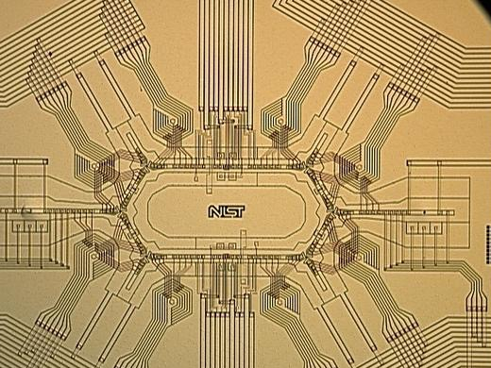
Atomic ion experimental groups pursuing
quantum information & quantum computers :
Aarhus
Amherst
The Citadel
Tsinghua (Bejing)
U.C. Berkeley
U.C.L.A.
Duke
ETH (Zürich)
Freiburg
Garching (MPQ)
Georgia Tech
Griffiths
Hannover
Innsbruck
JQI (U. Maryland)
Lincoln Labs
Imperial (London)
Mainz
MIT
NIST
Northwestern
NPL
Osaka
Oxford
Paris (Université Paris)
Pretoria, S. Africa
PTB
Saarland
Sandia National Lab
Siegen
Simon Fraser
Singapore
SK Telecom, S. Korea
Sussex
Sydney
U. Washington
Weizmann Institute
+ many other platforms:
neutral atoms, Josephson junctions,
quantum dots, NV centers in diamond,
single photons, …

Slide 27
Scale up ion qubit numbers?
● small electrodes: use lithographic techniques
● move ions in multi-zone arrays for scaling
microfab at:
GTRI, Sandia, NIST,
Berkeley, Innsbruck,
Mainz, ….
1 mm
State of play?
Jason Amini et al.
(NIST)

Slide 28
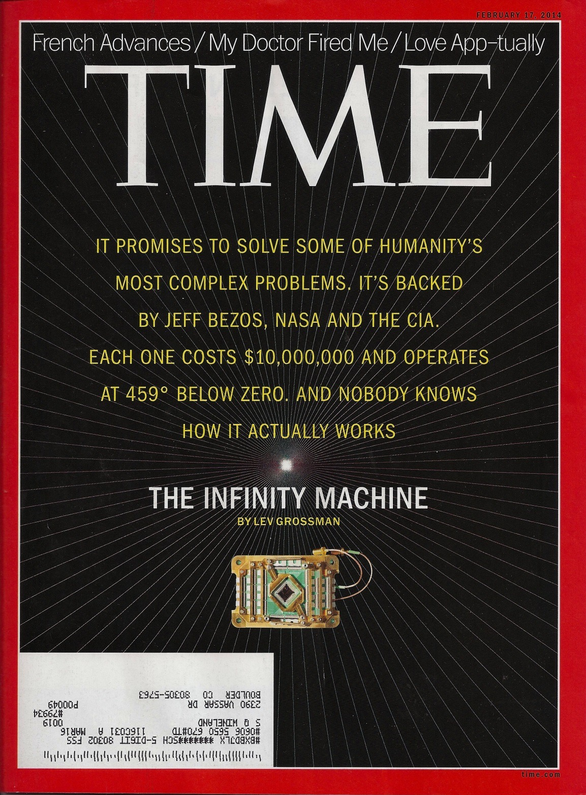
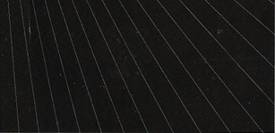
Time magazine
(February 17, 2014)
Article about D-Wave
“quantum computer”

Slide 29
Time magazine
(February 17, 2014)
Article about D-Wave
“quantum computer”
A quantum computer can:
“HELP CARS DRIVE
THEMSELVES Google is
using a quantum computer
to design software that can
distinguish cars from landmarks”
“BOOST GDP
Hyperpersonalized advertising,
based on quantum computation,
will simulate consumer spending”
Wow!

Slide 30
Time magazine
Article about D-Wave
quantum computer
February 17, 2014

Slide 31
Realism:
WE DO KNOW HOW IT WORKS
…and why it doesn’t work
FACTORING MACHINE
probably decades away
QUANTUM SIMULATION
maybe within next decade?

Slide 32
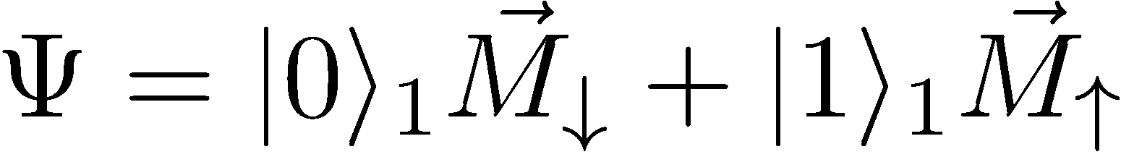
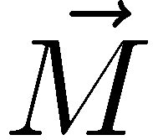
Special state made with quantum computer:
Schrödinger’s cat?
For large N
macroscopic
magnetization

Slide 33
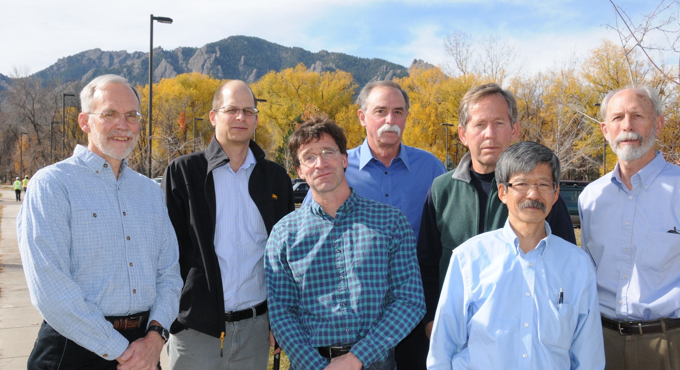

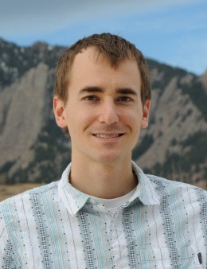
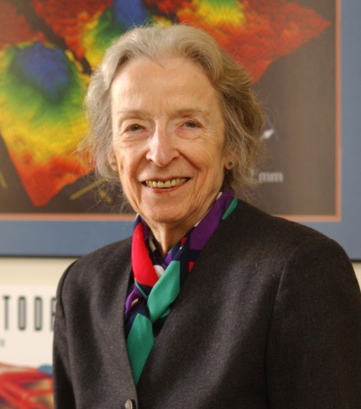






NIST group: collaboration of many people
●
John
Bollinger
Till
Rosenband
Dave
Wineland
Jim
Bergquist
Bob
Drullinger
Didi
Leibfried
Wayne
Itano
Chris Monroe
(now at U. Maryland)
Dave Leibrandt
● plus students, postdocs, visitors (> 100)
● institutional support: Helmut Hellwig, Sam Stein,
Don Sullivan, Tom O’Brian, Carl Williams, Katharine Gebbie…
Katharine Gebbie

Slide 34
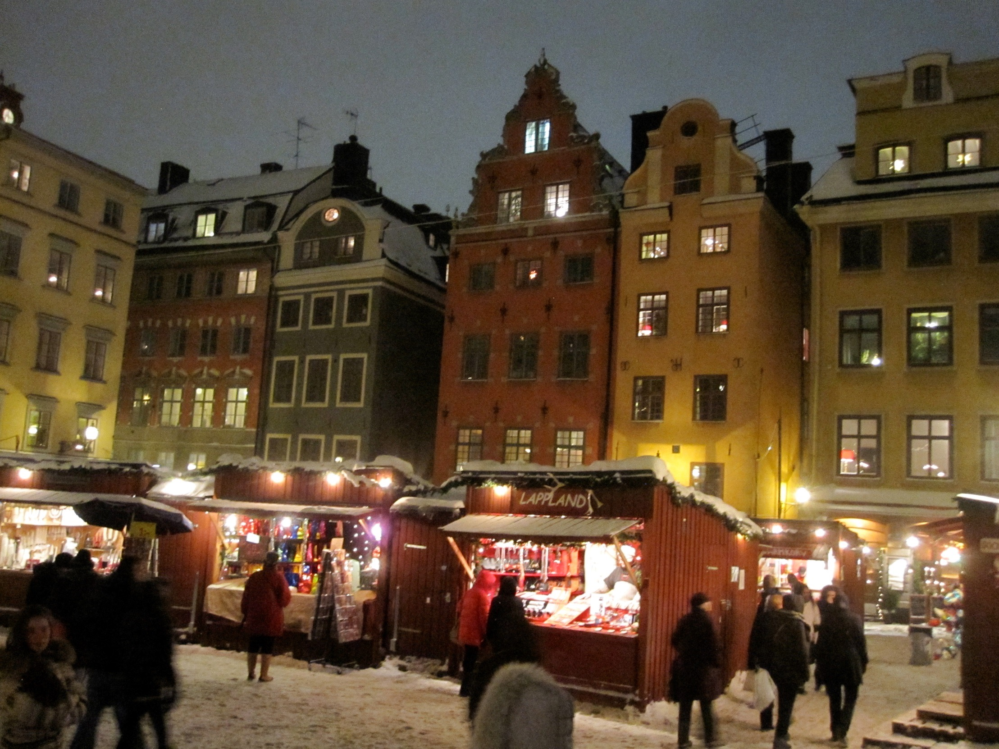
Stockholm
(December, 2012)

Slide 35
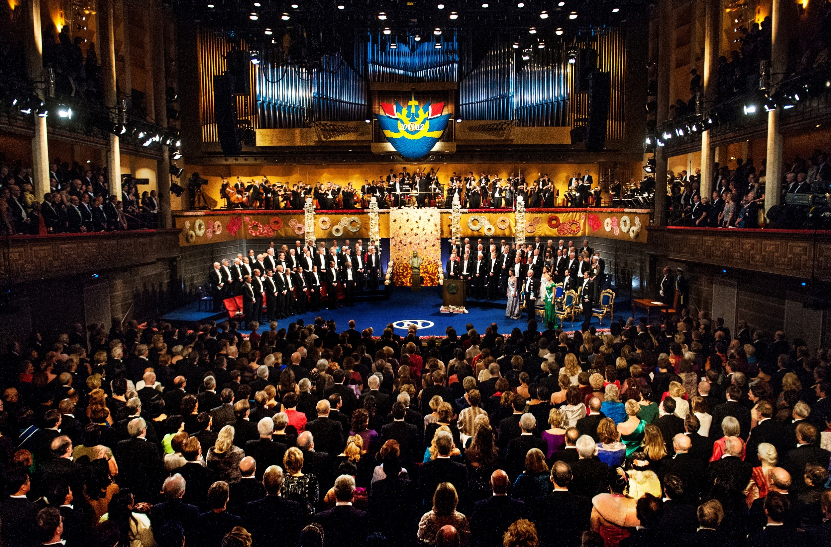
Nobel award ceremony
(Stockholm Concert Hall)

Slide 36
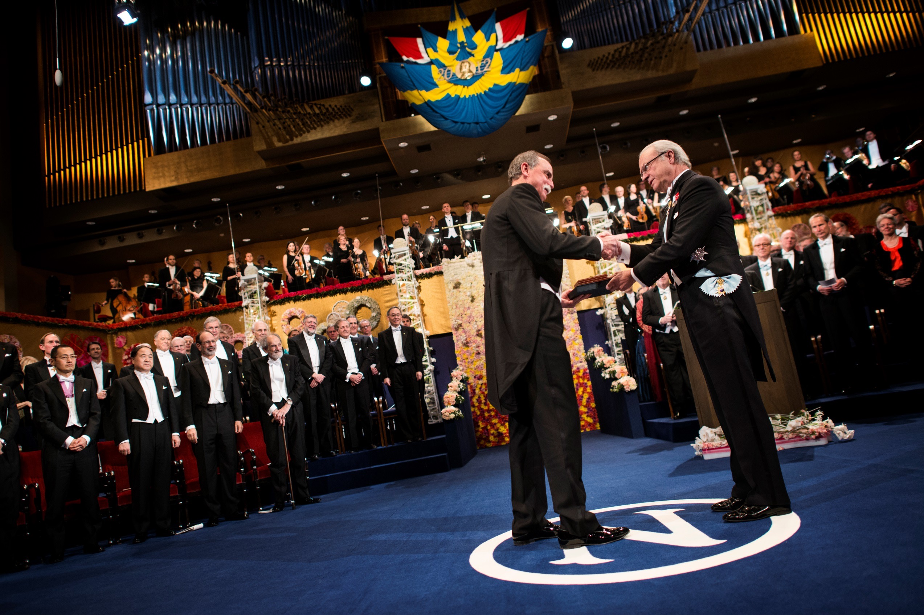

Slide 37
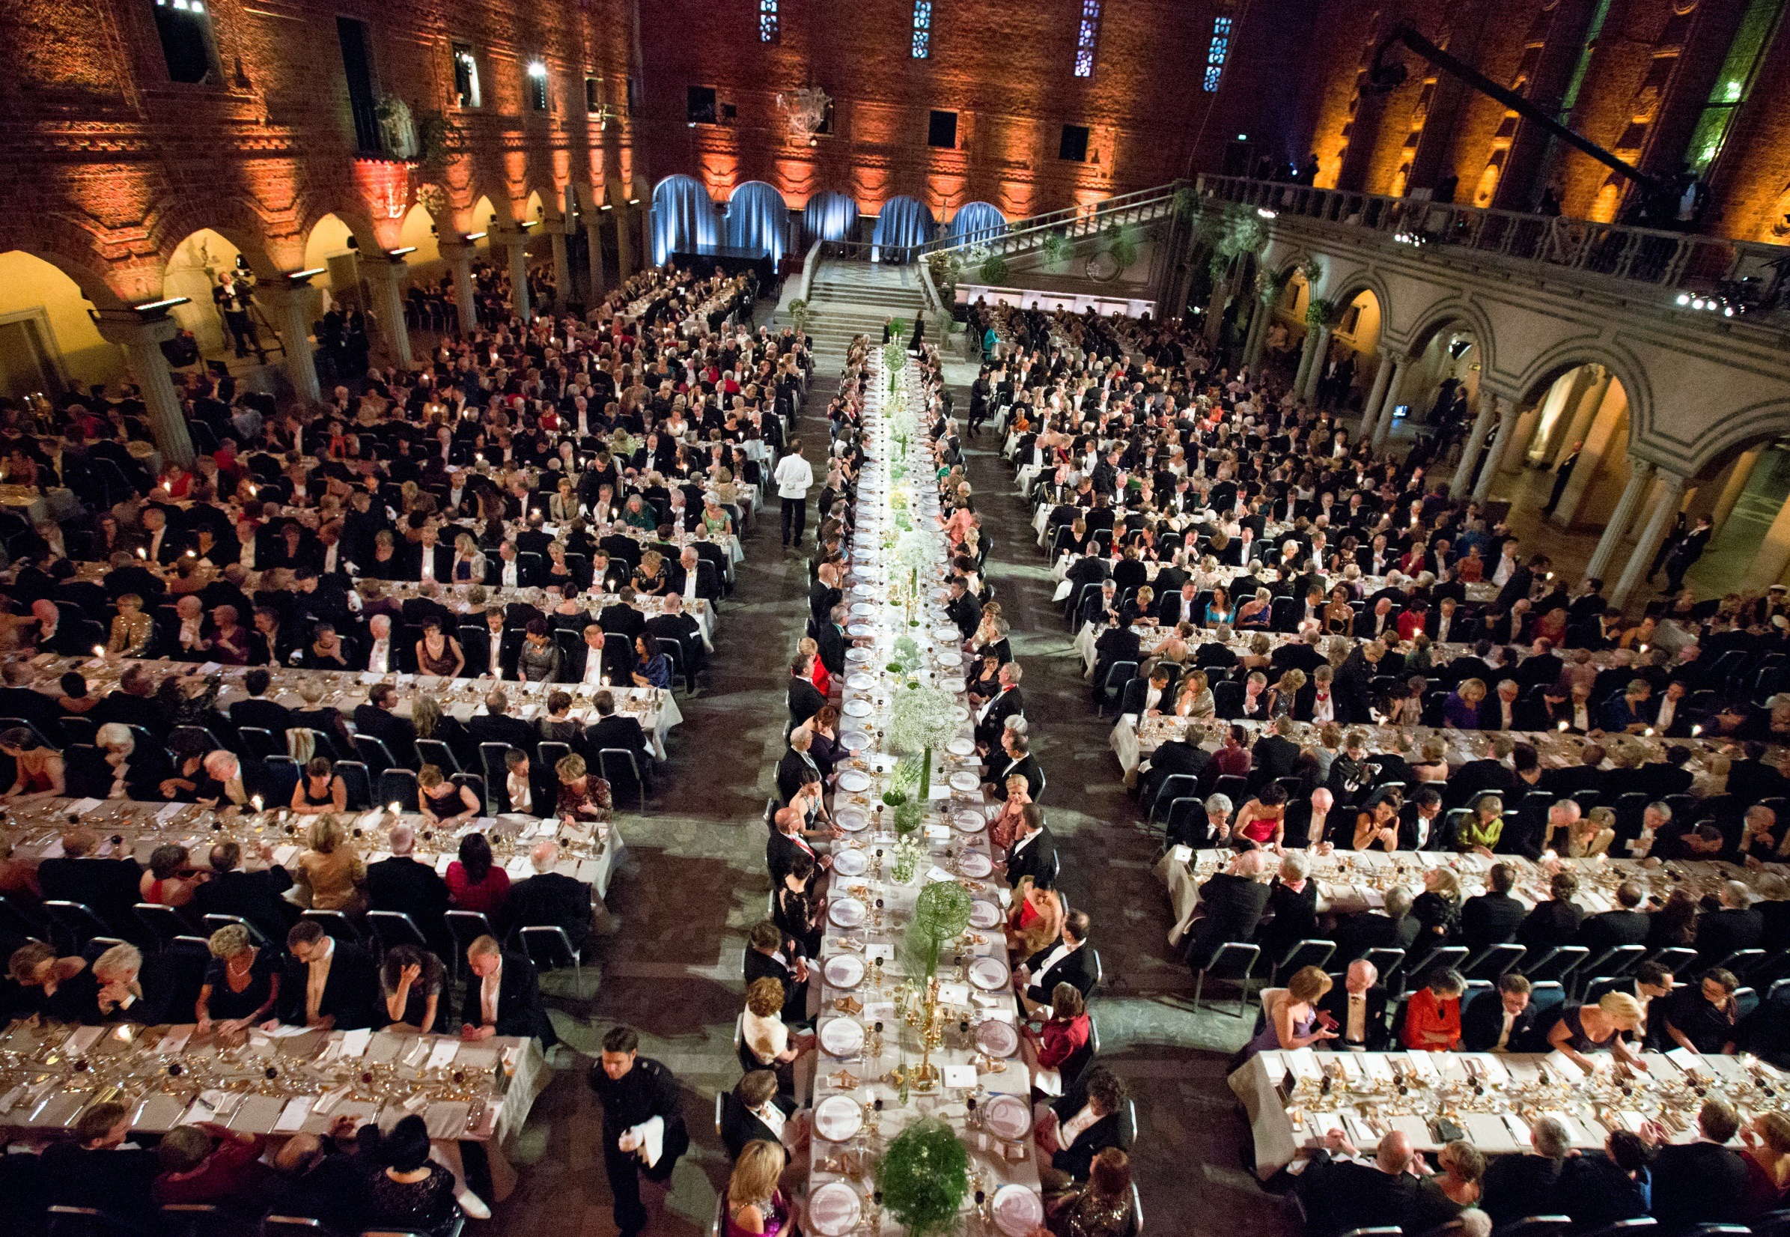
Banquet
(Stockholm City Hall)

Slide 38
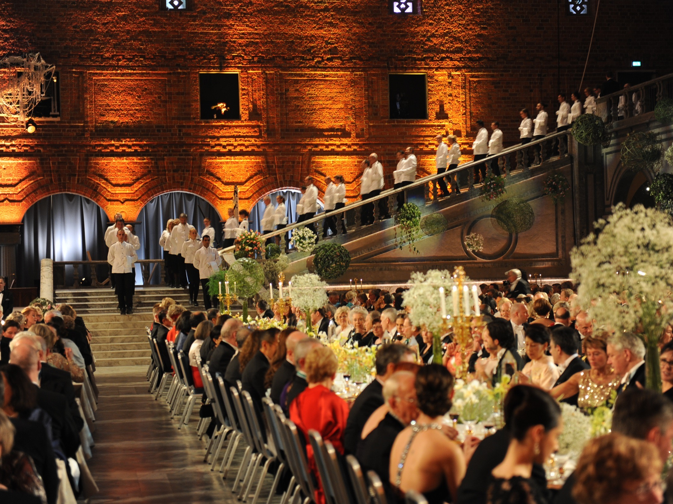
Banquet
Choreography

Slide 39
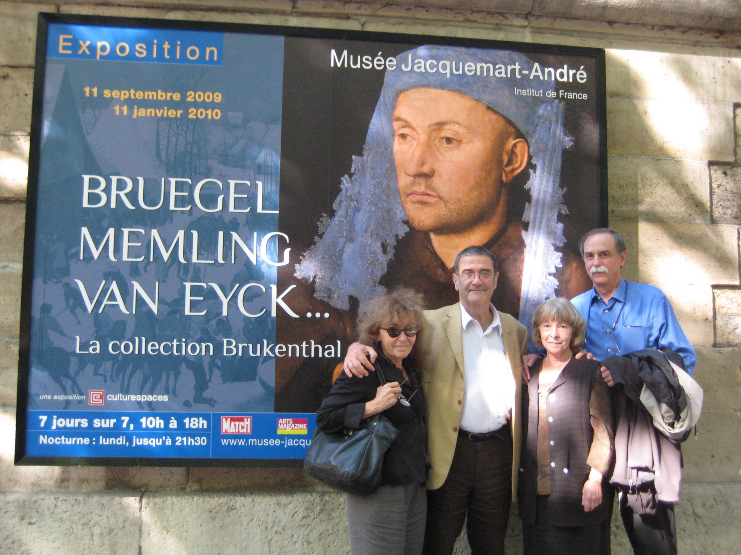
And good friends along the way!
Claudine
Haroche
Serge
Haroche
Sedna
Wineland

Slide 40
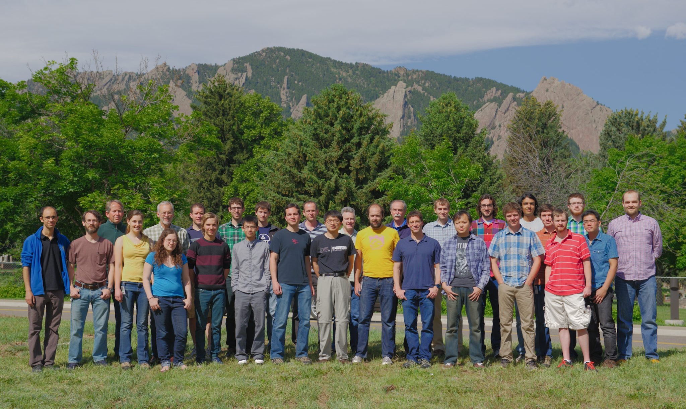
NIST IONS, June 2014
Jim Bergquist, John Bollinger, Joe Britton, Justin Bonet, Ryan Bowler, John Gaebler, Andrew Wilson, Dave Wineland, David Leibrandt, Peter Burns, Raghu Srinivas, Shon Cook, Robert Jordens
David Hume Ting Rei Tan
Shlomi Kotler, Dustin Hite, Katie McCormick ,Susanna Todaro, Leif Waldner, Yiheng Lin, Daniel Slichter, James Chou, David Allcock, Didi Leibfried, Jwo-Sy Chen, Sam Brewer, Kyle McKay
Not pictured: Brian Sawyer, Till Rosenband, Wayne Itano, Dave Pappas, Bob Drullinger

